Slide 1
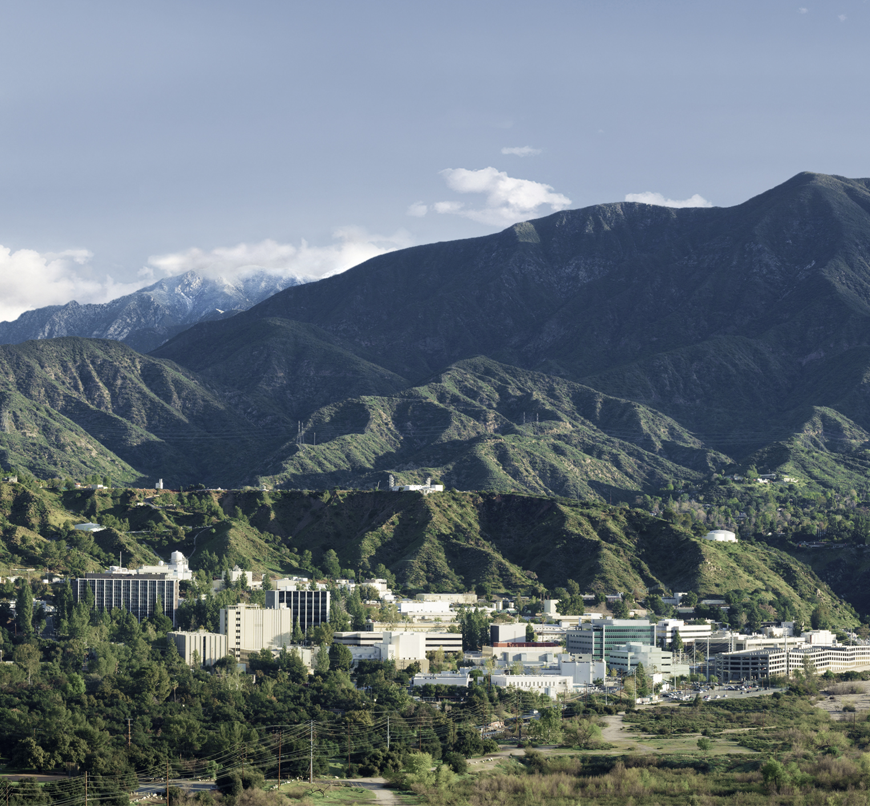
Specific Heat Capacities of Low Temperature Water—Ammonia Mixtures Down to the Eutectic
Bing Hong Chua
3226 – Planetary Interiors and Geophysics
Mentors: Dr. Steven D. Vance
Dr. Mathieu Choukroun

Slide 2
Abstract
Obtained low temperature specific heat measurements of H₂O – NH₃ mixtures
Highlight inaccuracies in the currently adopted equation of state
Provide novel data for constructing a new equation of state
Contribute to improving accuracy of planetary models

Slide 3

Introduction
the water—ammonia system
Abundant in the outer solar system
Interior Structure
anti-freeze enables subsurface oceans
Habitability
source of reduced nitrogen for abiotic amino acid synthesis
A. Angelich (NRAO/AUI/NSF)/ ALMA/ ESO

Slide 4
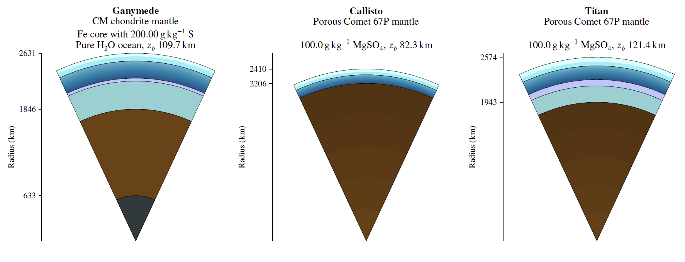
Introduction
the pipeline
Geophysical Models
Equations of State (EoS)
Thermodynamic Data
isobaric specific heat capacity (C_{p})
Styczinszki et al., 2022 (preprint)

Slide 5
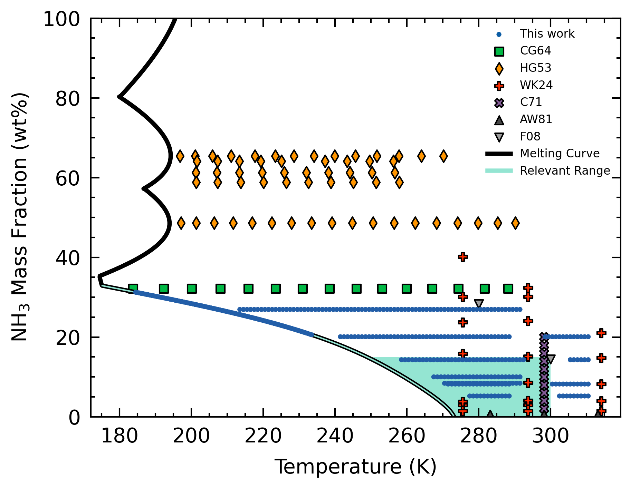
Introduction
the current C_{p} understanding
Current EoS by Tillner-Roth & Friend, 1998
Sparse data in the parameter space relevant to planetary studies (low T, low composition)
Motivation provide novel C_{p} data in desired parameter space

Slide 6
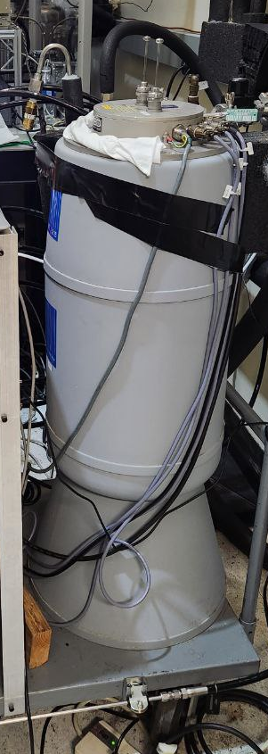
Methods
differential scanning calorimetry (DSC)
sample
reference
Principle: measures difference in heat flow between sample and reference cells
Temperature profile
Cool to 120 K
Heat at 0.1 K min⁻¹
End at 300 or 320 K
~4 days per experiment

Slide 7
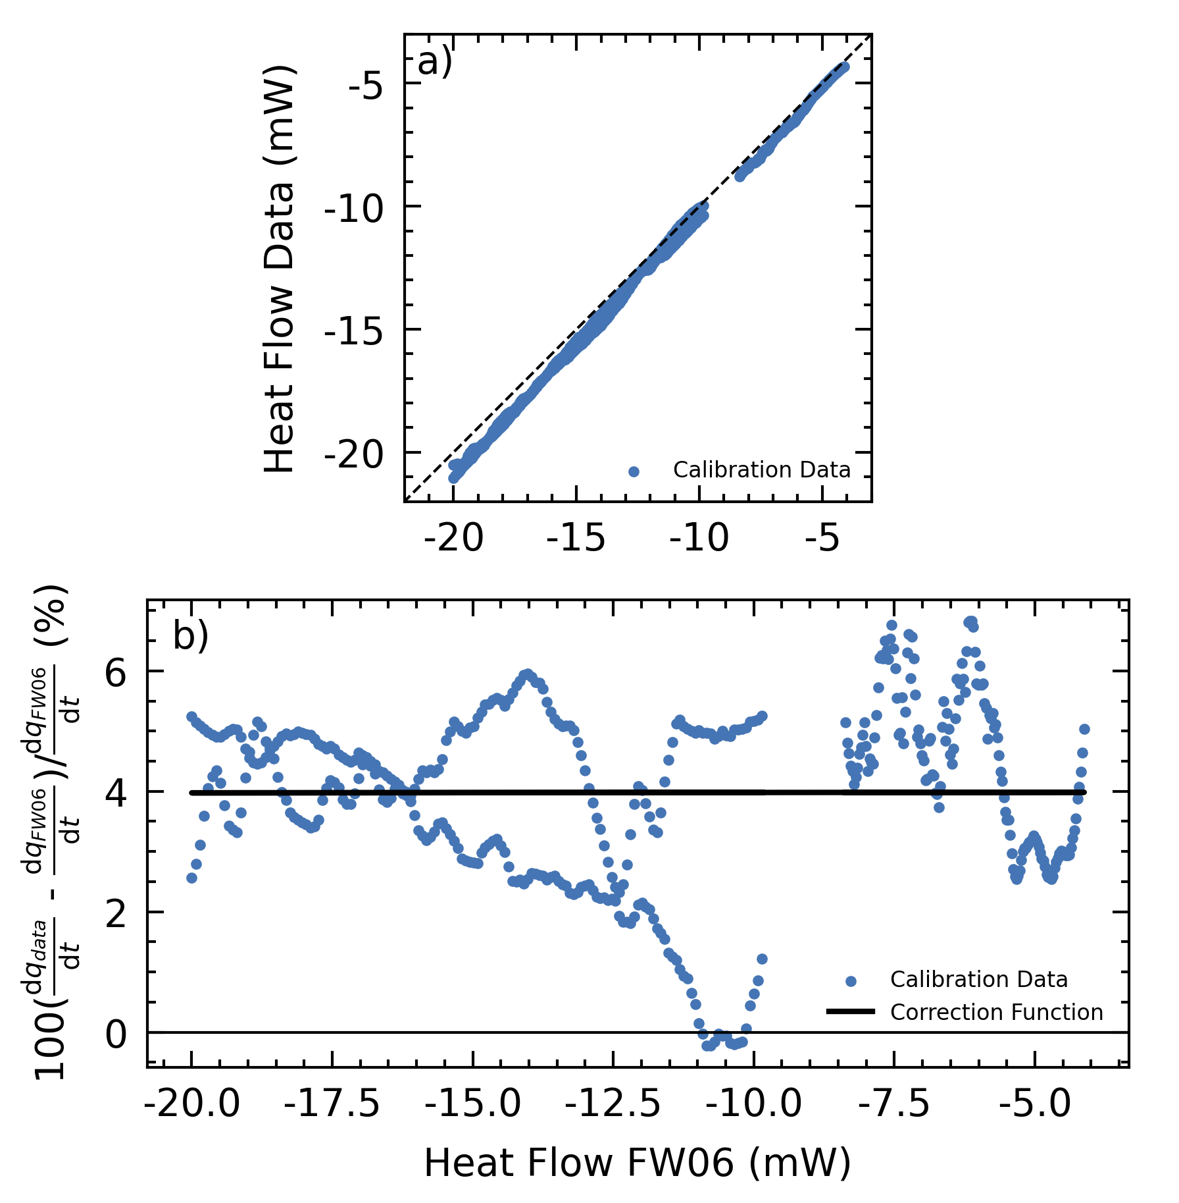
Methods
calibration
Pure water—ice
Systematic deviation from Feistel & Wagner, 2006
Correction function applied to all samples

Slide 8
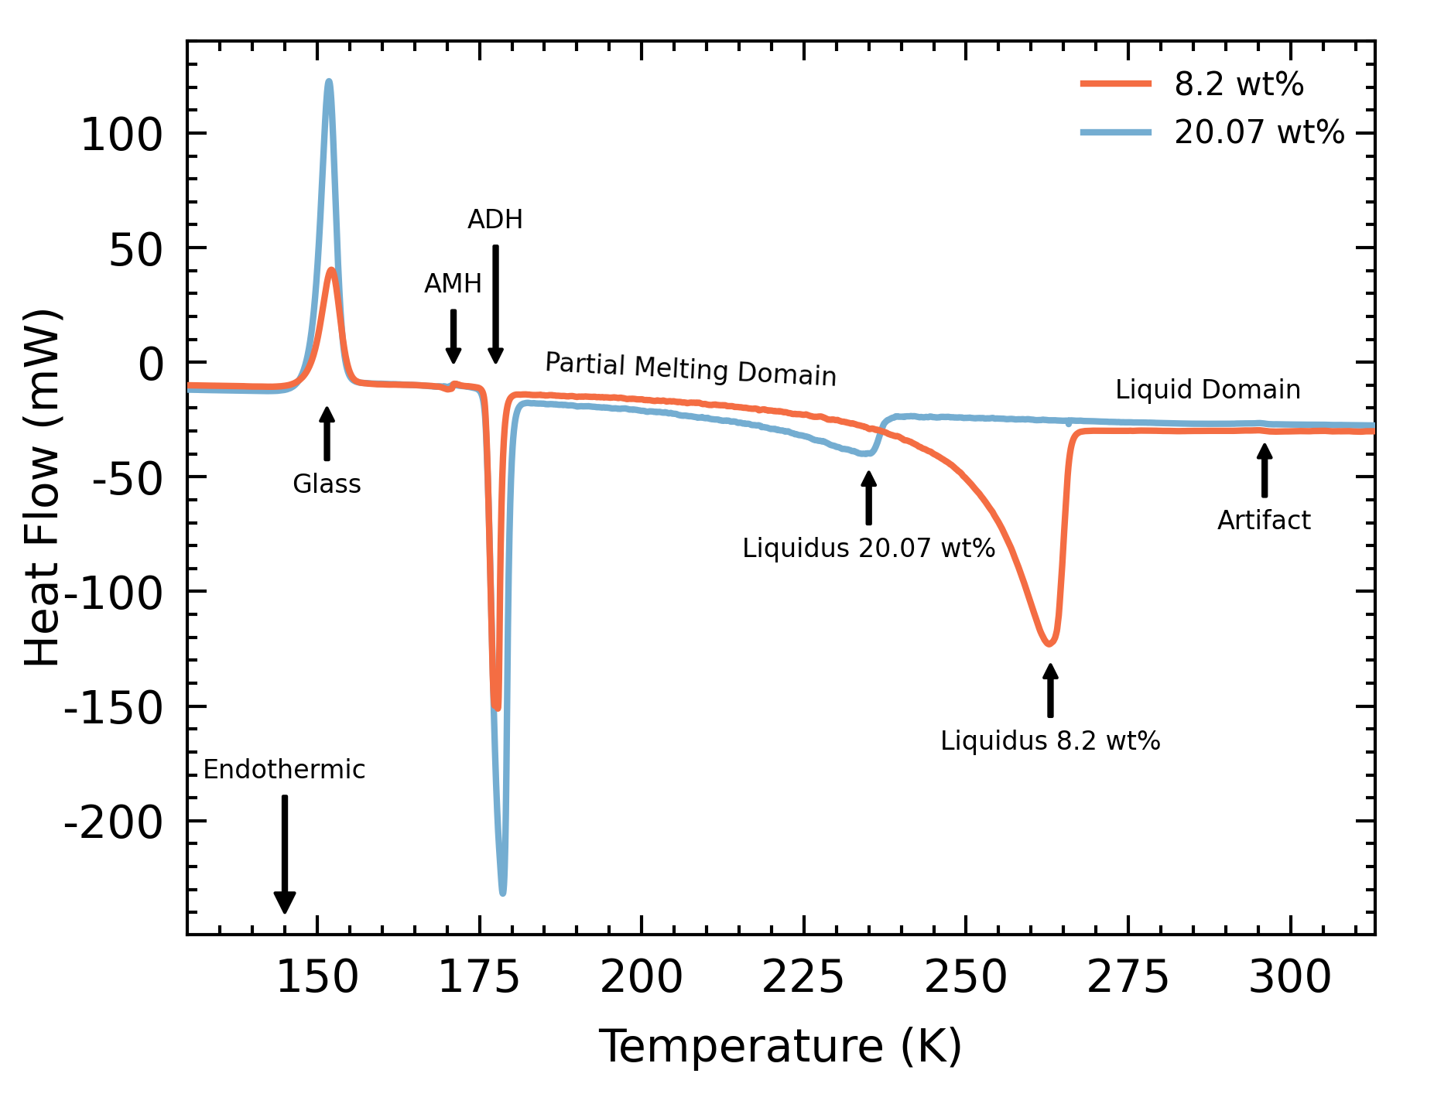
Methods
heat flow thermogram
Liquidus point
Determine ammonia concentration
Instrument noise
3-K bin average
Two phase domains
Pure liquid domain
Partial melting domain

Slide 9
Methods
heat flow thermogram
Liquidus point
Determine ammonia concentration
Instrument noise
3-K bin average
Two phase domains
Pure liquid domain
Partial melting domain

Slide 10
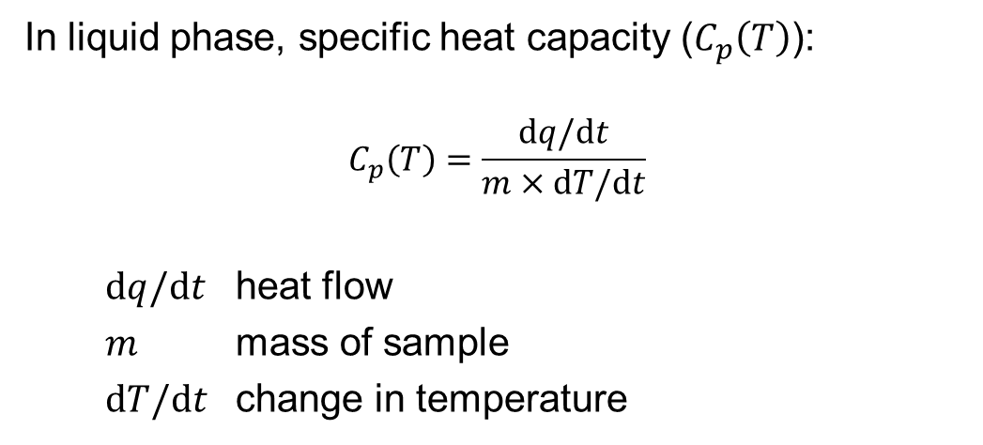
Methods
specific heat extraction
In liquid phase, specific heat capacity ($C_{p}\left(T\right)$):
$$C_{p}\left(T\right)=\frac{dq/dt}{m×dT/dt}$$
$dq/dt$ heat flow
$m$ mass of sample
$dT/dt$ change in temperature

Slide 11
Methods
specific heat extraction
In partial melting domain, multiple processes:
Melting of ice
Heating of ice fraction
Mixing of melted ice
Heating of liquid fraction
Assumes system equilibrium

Slide 12
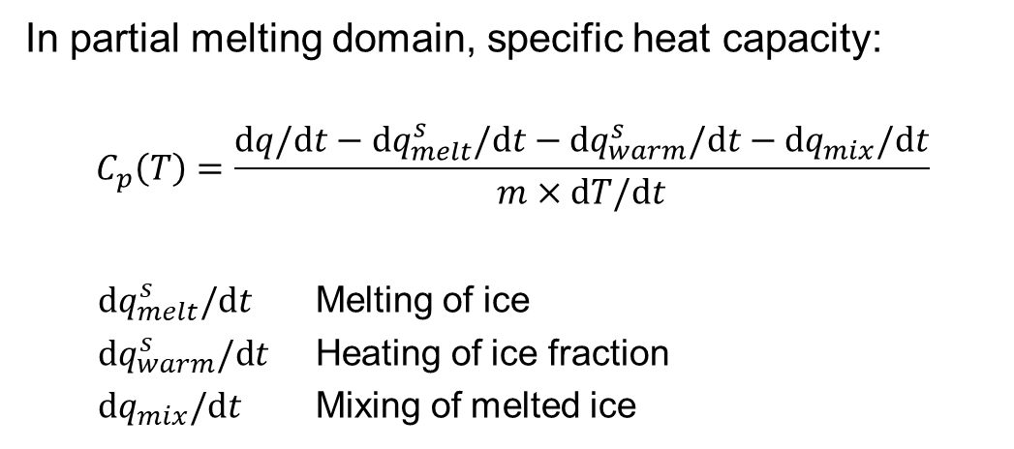
Methods
specific heat extraction
In partial melting domain, specific heat capacity:
$$C_{p}\left(T\right)=\frac{dq/\text{d}t−\text{d}q_{melt}^{s}/\text{d}t−\text{d}q_{warm}^{s}/\text{d}t−\text{d}q_{mix}/\text{d}t}{m×\text{d}T/\text{d}t}$$
$\text{d}q_{melt}^{s}/\text{d}t$ Melting of ice
$\text{d}q_{warm}^{s}/\text{d}t$ Heating of ice fraction
$\text{d}q_{mix}/\text{d}t$ Mixing of melted ice

Slide 13
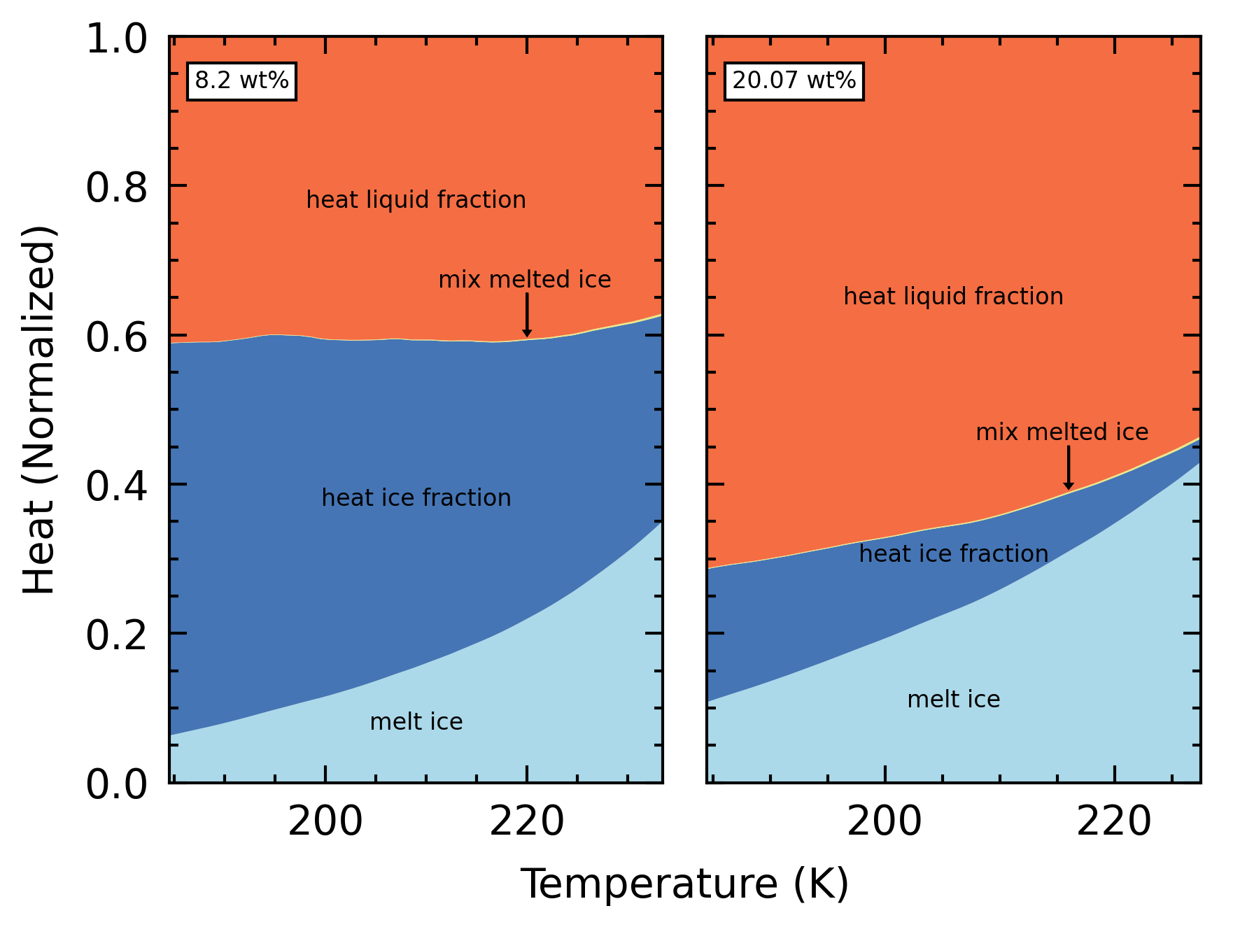
Methods
specific heat extraction
Minimal heat for mixing
Lower concentration → lower proportion to heat liquid fraction
Higher temperature → rapid ice melting → system in disequilibrium

Slide 14
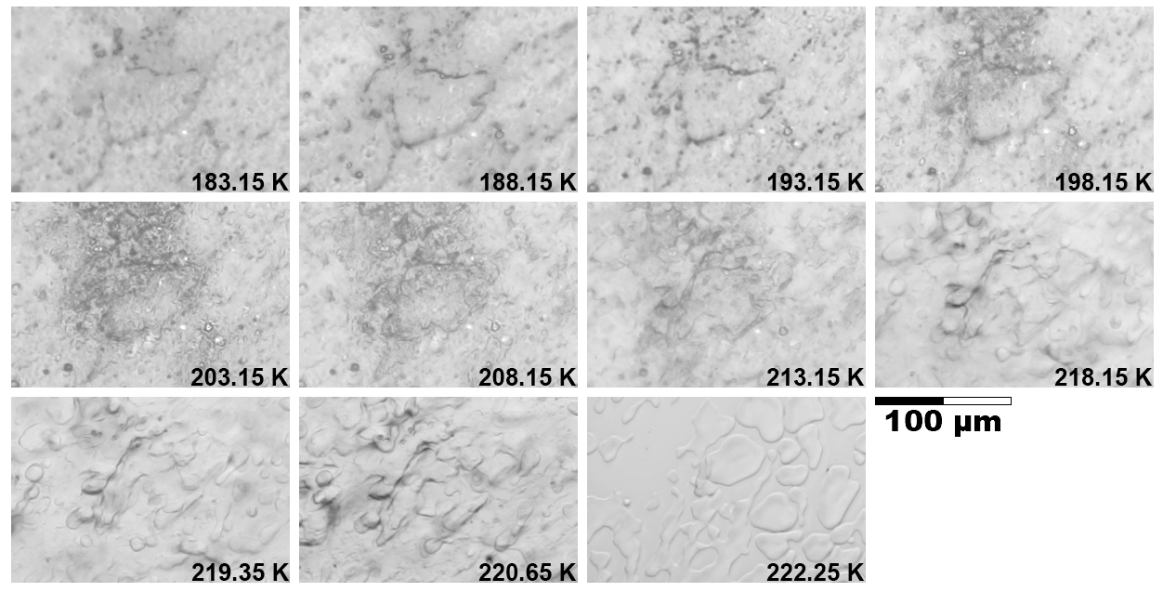
Methods
microscopy
Assess equilibrium assumption
Melting proceeds gradually, with no crystal regrowth or melt migration.
At high temperatures, melting proceeds rapidly.

Slide 15
Methods
overview
Run calorimeter
Apply correction
Decompose thermodynamic processes
Calculate liquid phase C_{p}
Calculate partial melting domain C_{p}

Slide 16
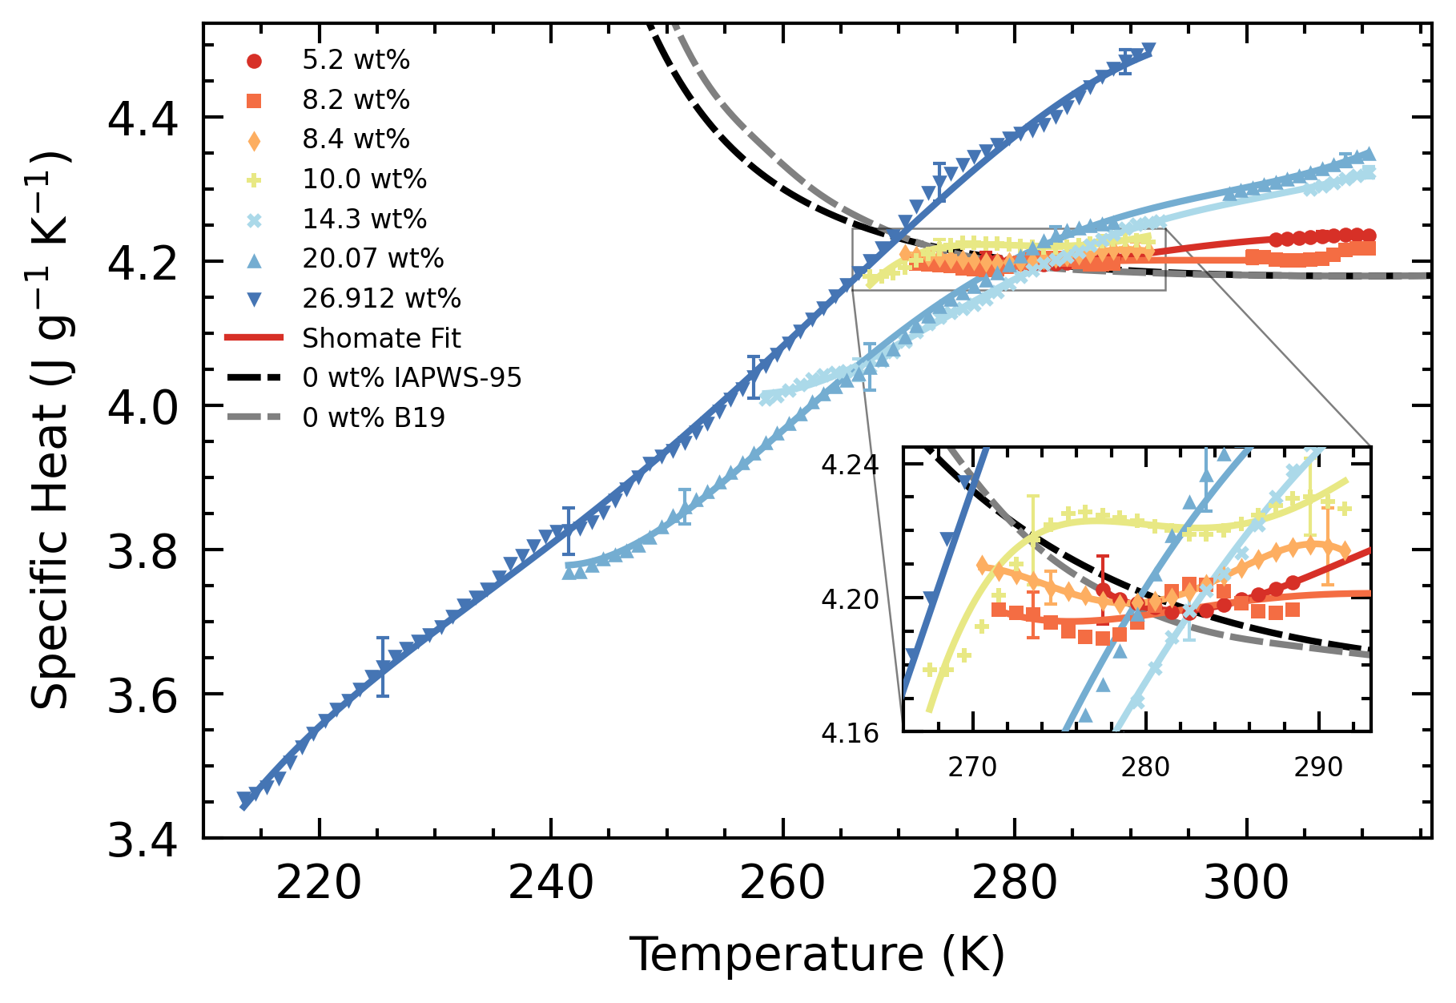
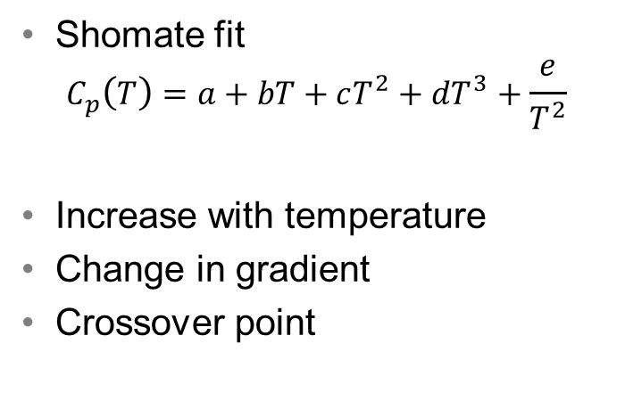
Results
liquid phase C_{p}
Shomate fit
$$C_{p}\left(T\right)=a+bT+cT^{2}+dT^{3}+\frac{e}{T^{2}}$$
Increase with temperature
Change in gradient
Crossover point

Slide 17
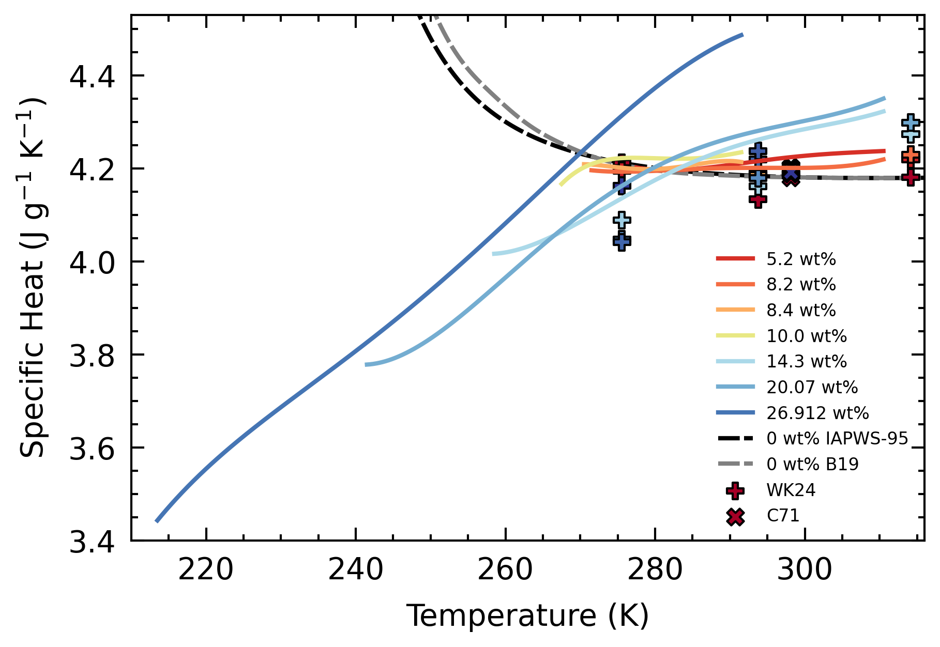
Results
liquid phase C_{p}
Compared with literature values
General agreement
Magnitude
Trend

Slide 18
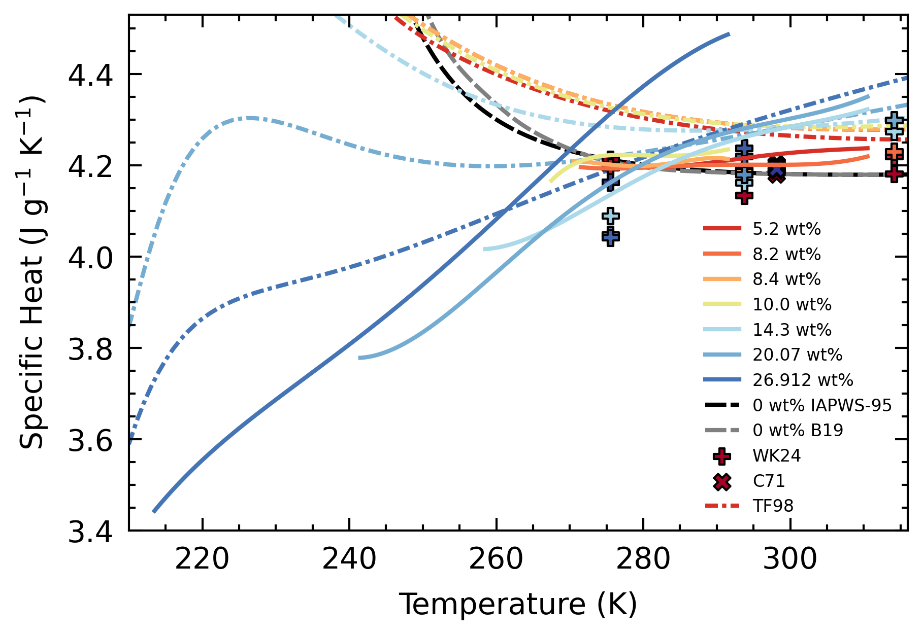
Results
liquid phase C_{p}
Compared with EoS
Magnitude
smaller than EoS
Gradient
steeper than EoS
Crossover point temperature
lower than EoS

Slide 19
Results
liquid phase C_{p}
EoS is a combination of water and ammonia EoS
Super-cooled state of water
C_{p} increases rapidly
Behavior transposed onto H₂O—NH₃ system
Data suggests a stronger suppression of this behavior

Slide 20
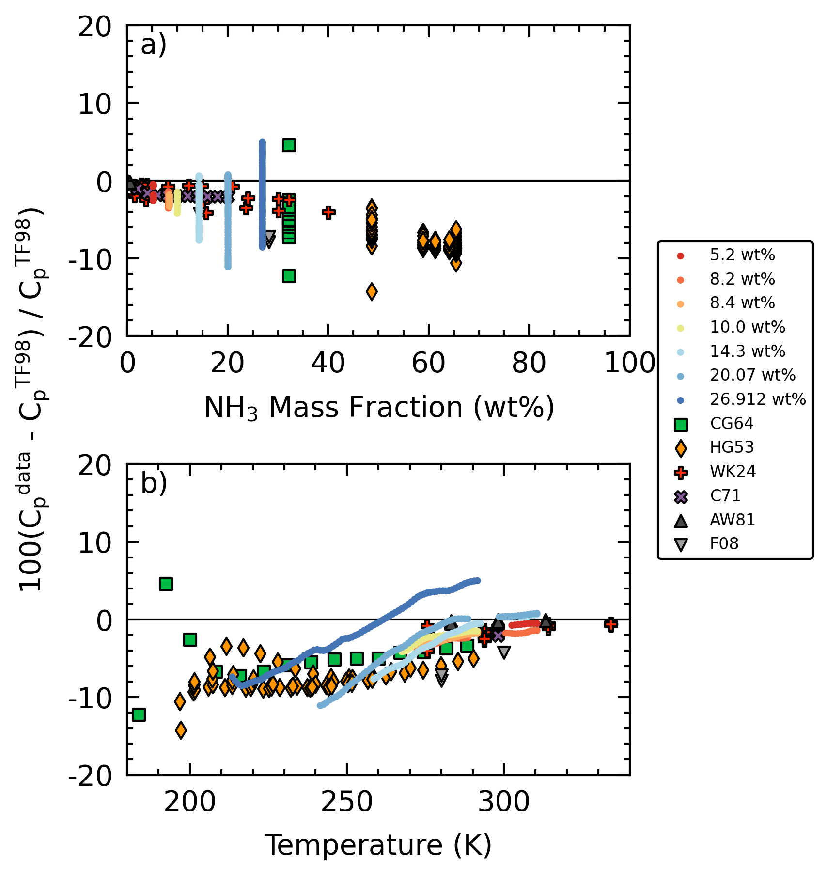
Results
liquid phase C_{p}
Deviations decrease with increasing temperature
Tapers off and stabilize

Slide 21
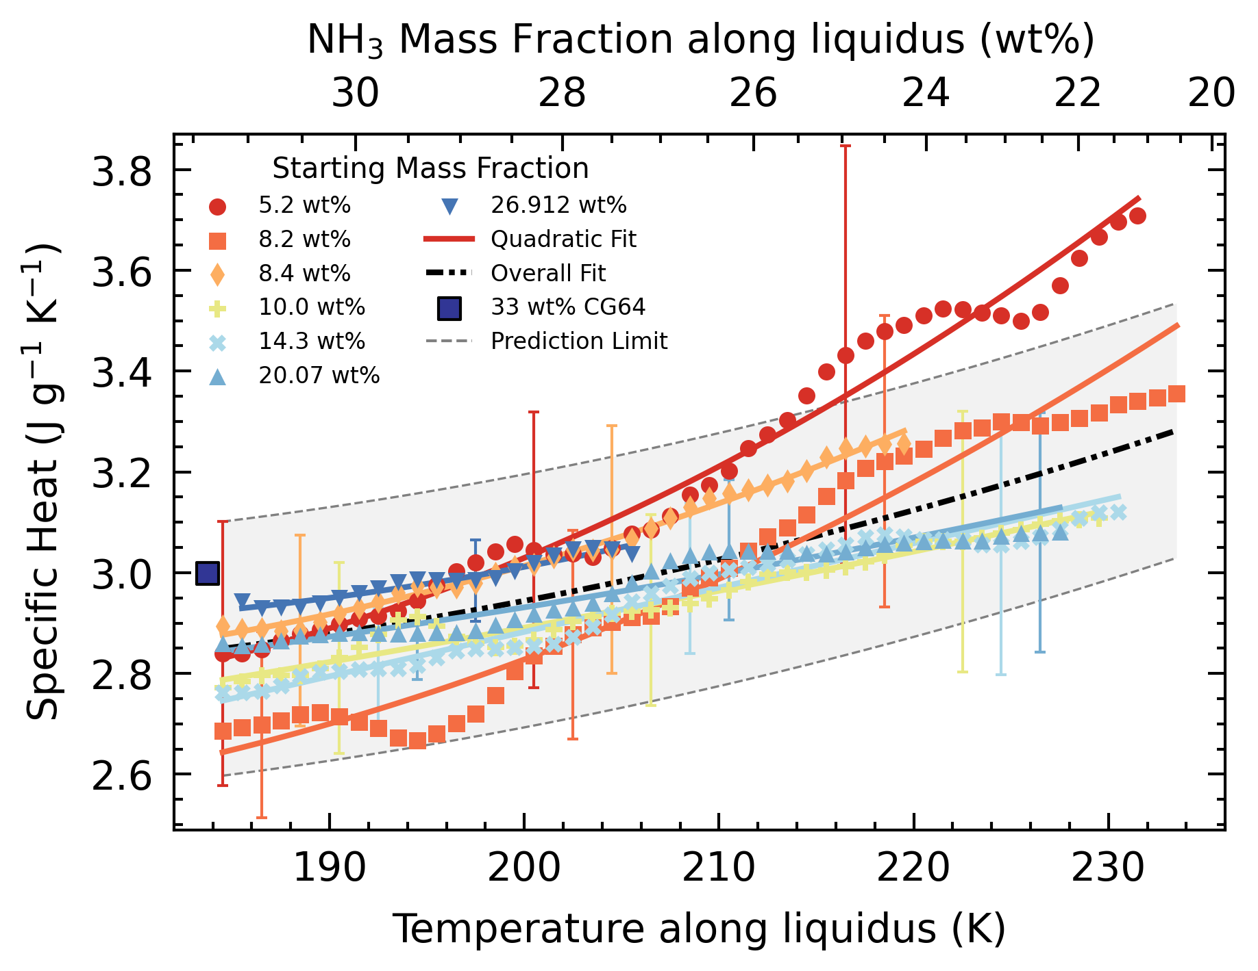
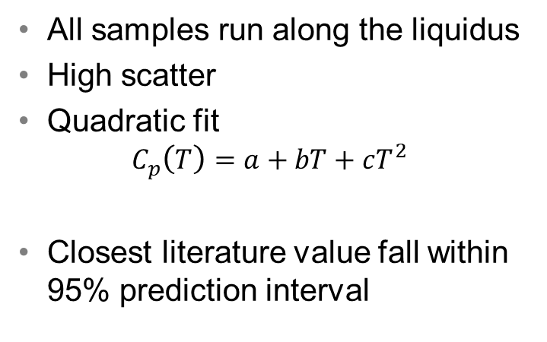
Results
partial melting domain C_{p}
All samples run along the liquidus
High scatter
Quadratic fit
$$C_{p}\left(T\right)=a+bT+cT^{2}$$
Closest literature value fall within 95% prediction interval

Slide 22
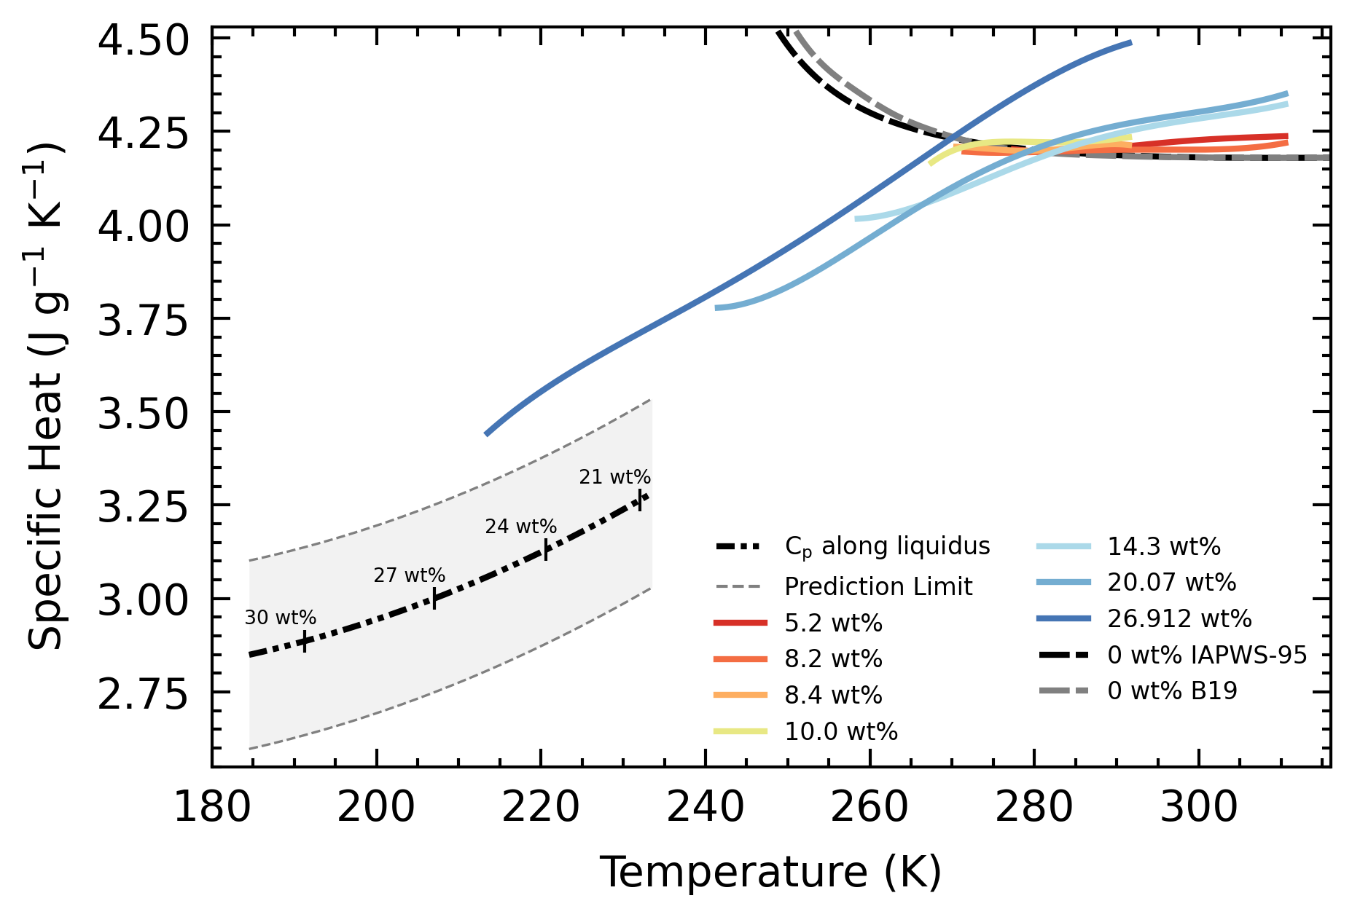
Results
partial melting domain C_{p}
In theory, along liquidus C_{p} should align with liquid phase C_{p}

Slide 23
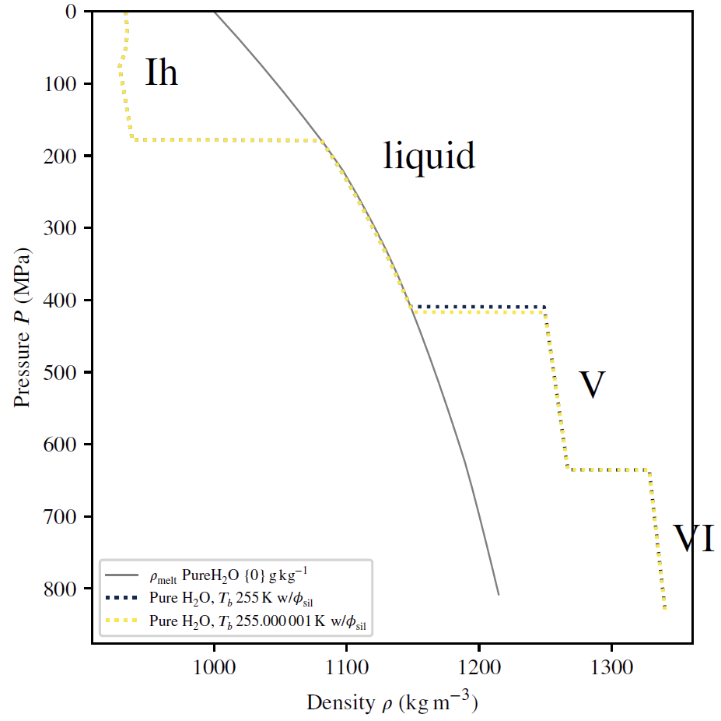
Discussion
interior models
Assess effect of change in C_{p}
Pure water ocean, but with C_{p} modified by deviations of 5.2 wt% from EoS.
Lower ocean C_{p} → Warmer adiabatic profile → Thicker ocean, Thinner high pressure ice
Original C_{p}
Modified C_{p}

Slide 24
Discussion
interior models
Assess effect of change in C_{p}
Pure water ocean, but with C_{p} modified by deviations of 5.2 wt% from EoS.
Lower ocean C_{p} → Warmer adiabatic profile → Thicker ocean, thinner high pressure ice (4.55 km)
Original C_{p}
Modified C_{p}

Slide 25
Discussion
interior models
Only C_{p} tested
New EoS, other properties are also modified.
Original C_{p}
Modified C_{p}

Slide 26
Discussion
new equation of state
EoS in development by Journaux et al.
Better constrain the suppression of the critical behavior of super-cooled water at low concentrations
Especially relevant for conditions found on icy moons (< 270 K)

Slide 27
Conclusion
Geophysical Models
Equations of State (EoS)
Thermodynamic Data
isobaric specific heat capacity (C_{p})

Slide 28
Conclusion
Informs Science Objectives
Realistic Geophysical Models
Robust Equations of State (EoS)
Accurate Thermodynamic Data
isobaric specific heat capacity (C_{p})

Slide 29
Key References
Tillner-Roth, R.; Friend, D. G. A Helmholtz Free Energy Formulation of the Thermodynamic Properties of the Mixture {Water + Ammonia}. Journal of Physical and Chemical Reference Data 1998, 27, 63–96.
Chan, J. P.; Giauque, W. F. The Entropy of NH3·2H2O. Heat Capacity from 15 to 300°K.1. The Journal of Physical Chemistry 1964, 68, 3053–3057.
Wrewsky, M.; Kaigorodoff, A. I. Warmekapazitat wasseriger Losungen von Chlorwasserstoff und Ammoniak bei verschiedenen Temperaturen. Zeitschrift fur Physikalische Chemie 1924, 112U, 83–89.
Croft, S.; Lunine, J.; Kargel, J. Equation of state of ammonia-water liquid: Derivation and planetological applications. Icarus 1988, 73, 279–293.
Feistel, R.; Wagner, W. A New Equation of State for H2O Ice Ih. Journal of Physical and Chemical Reference Data 2006, 35, 1021–1047.
Journaux, B.; Brown, J. M.; Pakhomova, A.; Collings, I. E.; Petitgirard, S.; Espinoza, P.; Ballaran, T. B.; Vance, S. D.; Ott, J.; Cova, F.; Garbarino, G.; Hanfland, M.Holistic Approach for Studying Planetary Hydrospheres: Gibbs Representation of Ices Thermodynamics, Elasticity, and the Water Phase Diagram to 2, 300 MPa. Journal of Geophysical Research: Planets 2020, 125.
Wagner, W.; Pruß, A. The IAPWS formulation 1995 for the thermodynamic properties of ordinary water substance for general and scientific use. Journal of physical and chemical reference data 2002, 31, 387–535.
Journaux, B.; Brown, J. M.; Abramson, E.; Vance, S. The thermodynamics of ammonia rich planetary oceans: Equation of State for water-ammonia and water-ammonia-salt solutions from surface to abyssal conditions. AGU Fall Meeting Abstracts. 2021; pp P44A–08.
Vance, S. D.; Panning, M. P.; Stahler, S.; Cammarano, F.; Bills, B. G.; Tobie, G.; Kamata, S.; Kedar, S.; Sotin, C.; Pike, W. T.; Lorenz, R.; Huang, H.-H.; Jackson, J. M.; Banerdt, B. Geophysical Investigations of Habitability in Ice-Covered Ocean Worlds. Journal of Geophysical Research: Planets 2018, 123, 180–205.

Slide 30
Acknowledgements
Mentors – Steve, Mathieu, Mohit, Elodie, Marshall, Tuan, Baptiste for the guidance
Peers – summer, fall, winter interns for the company
JPL & Benoit – for the opportunity

Slide 31
To access additional layout options, on the Home tab, click the down arrow next to New Slide on the menu bar.
To obtain the appropriate marking and handling instructions for your information, visit the Marking and Handling Wizard at https://mh.jpl.nasa.gov and answer a few questions about the information's content. The Wizard complies with JPL’s Prime Contract requirements, and by implementing the marking and handling instructions provided by the Wizard, the document will be in compliance with JPL’s Marking and Handling requirements.
When you find your correct marking, copy it to your clipboard; then on the Insert tab, click Header & Footer, and paste it in the Footer box.

